Slide 1
AVL Trees

Slide 2
AVL Tree-
AVL trees are special kind of binary search trees.
In AVL trees, height of left subtree and right subtree of every node differs by at most one.
AVL trees are also called as self-balancing binary search trees.
AVL tree is a self-balancing binary search tree in which each node maintains extra information called a balance factor whose value is either -1, 0 or +1.

Slide 3
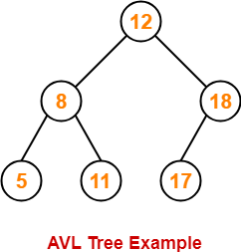
Example-
This tree is an AVL tree because-
It is a binary search tree.
The difference between height of left subtree and right subtree of every node is at most one.

Slide 4
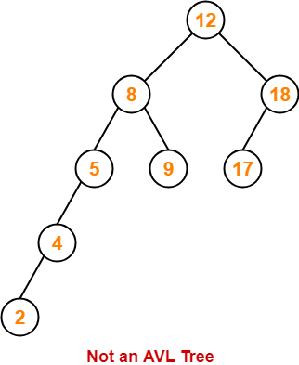
Following tree is not an example of AVL Tree-
This tree is not an AVL tree because-
The difference between height of left subtree and right subtree of root node = 4 – 2 = 2.
This difference is greater than one.

Slide 5
Balance Factor-
In AVL tree,
Balance factor is defined for every node.
Balance factor of a node = Height of its left subtree – Height of its right subtree
In AVL tree, Balance factor of every node is either 0 or 1 or -1.

Slide 6
AVL Tree Operations-
Search Operation
Insertion Operation
Deletion Operation
After performing any operation on AVL tree, the balance factor of each node is checked.

Slide 7
There are following two cases possible-
Case-01:
After the operation, the balance factor of each node is either 0 or 1 or -1.
In this case, the AVL tree is considered to be balanced.
The operation is concluded.
Case-02:
After the operation, the balance factor of at least one node is not 0 or 1 or -1.
In this case, the AVL tree is considered to be imbalanced.
Rotations are then performed to balance the tree.

Slide 8
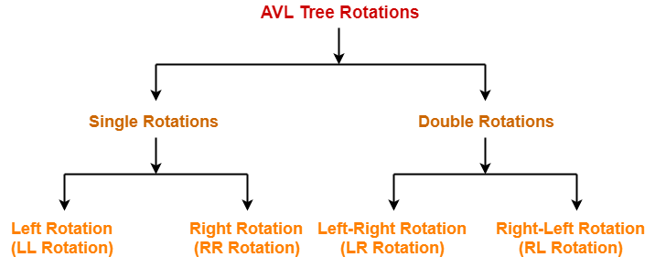
AVL Tree Rotations-
Rotation is the process of moving the nodes to make tree balanced.

Slide 9
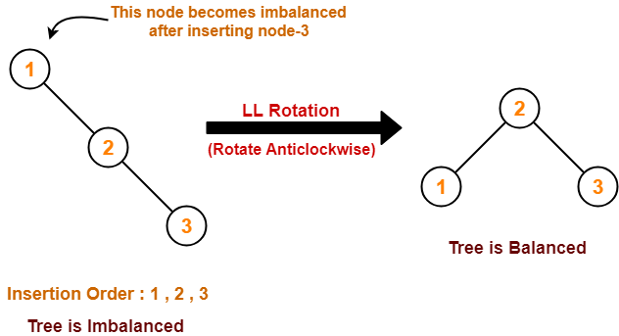
Cases Of Imbalance And Their Balancing Using Rotation Operations- Case I

Slide 10
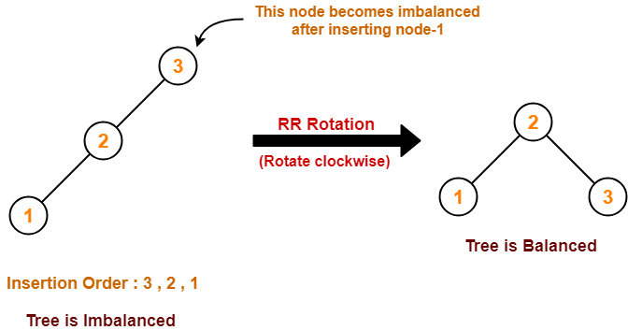
Case II-

Slide 11
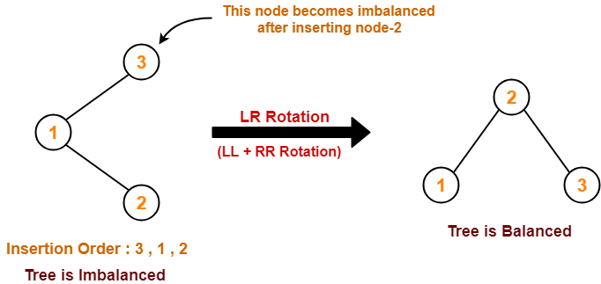
Case III-

Slide 12
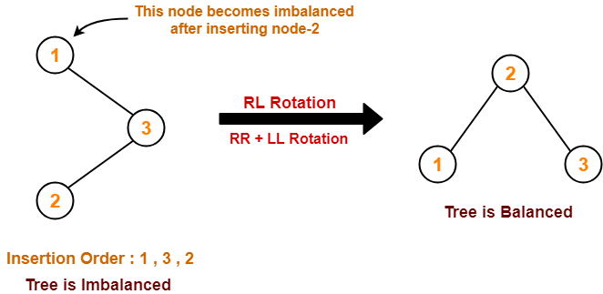
Case IV-

Slide 13
Example
Create AVL Tree- 20,45,22,45,10,8,9

